Slide 1

MACHINE LEARNING ACCELERATOR
Tabular Data – Lecture 3

Slide 2
Course Overview
Lecture 1
Lecture 2
Lecture 3
Introduction to ML
Model Evaluation
Train-Validation-Test
Overfitting
Exploratory Data Analysis
K Nearest Neighbors (KNN)
Feature Engineering
Tree-based Models
Decision Tree
Random Forest
Hyperparameter Tuning
AWS AI/ML Services
Optimization
Regression Models
Regularization
Boosting
Neural Networks
AutoML

Slide 3
Optimization

Slide 4
Optimization in Machine Learning
We build and train ML models, hoping for:
In reality …
Learn better and better models, such that overall model error gets smaller and smaller … ideally, as small as possible!
ML Model Features
ML Model (Rules)
ML Model Target
error
ML Model Features
ML Model (Rules)
ML Model Prediction

Slide 5
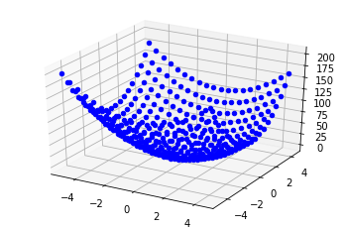
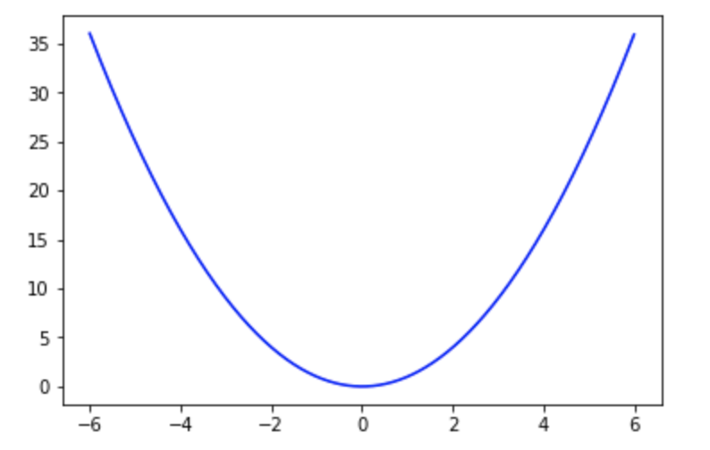
Optimization
In ML, use optimization to minimize an error function of the ML model
Error function: , where = input, = function, = output
Optimizing the error function:
Minimizing means finding the input that results in the lowest value
Maximizing, means finding that gives the largest

Slide 6
Gradient Optimization
Gradient: direction and rate of the fastest increase of a function.
It can be calculated with partial derivatives of the function with respect to each input variable in .
Because it has a direction, the gradient is a “vector”.

Slide 7
Gradient Example
, with gradient vector
Sign of the gradient shows direction the function increases: + right and – left

Slide 8
Gradient Example
, with gradient vector
Sign of the gradient shows direction the function increases: + right and – left

Slide 9
Gradient Example
, with gradient vector
Sign of the gradient shows direction the function increases: + right and – left
As we go towards to the bottom part of the function, gradient gets smaller

Slide 10
Gradient Example
, with gradient vector
Sign of the gradient shows direction the function increases: + right and – left
As we go towards to the bottom part of the function, gradient gets smaller and becomes zero (i.e., function can no longer change, can no longer decrease – it reached the min!)

Slide 11

Gradient Descent Method
Gradient Descent method uses gradients to find the minimum of a function iteratively.
Taking steps (proportional to the gradient size) towards the minimum, in the opposite direction of the gradient.
Gradient Descent Algorithm:
Start at an initial point
Update:

Slide 12
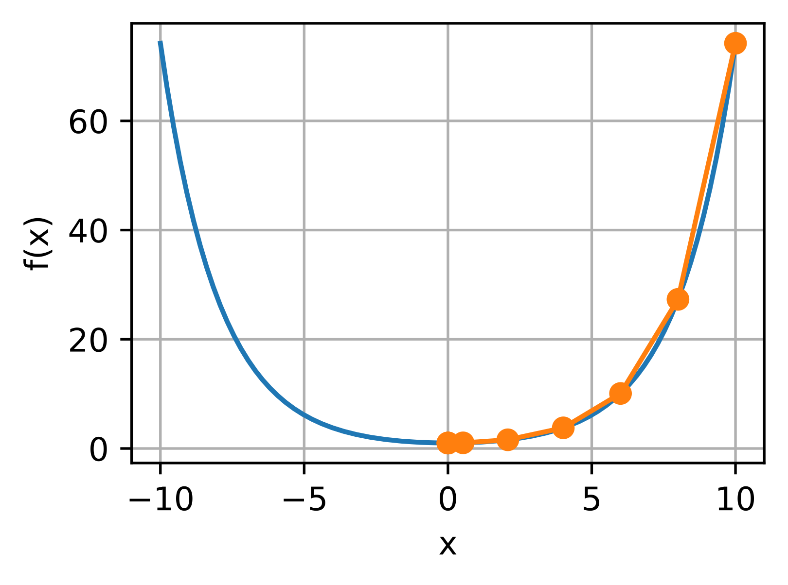
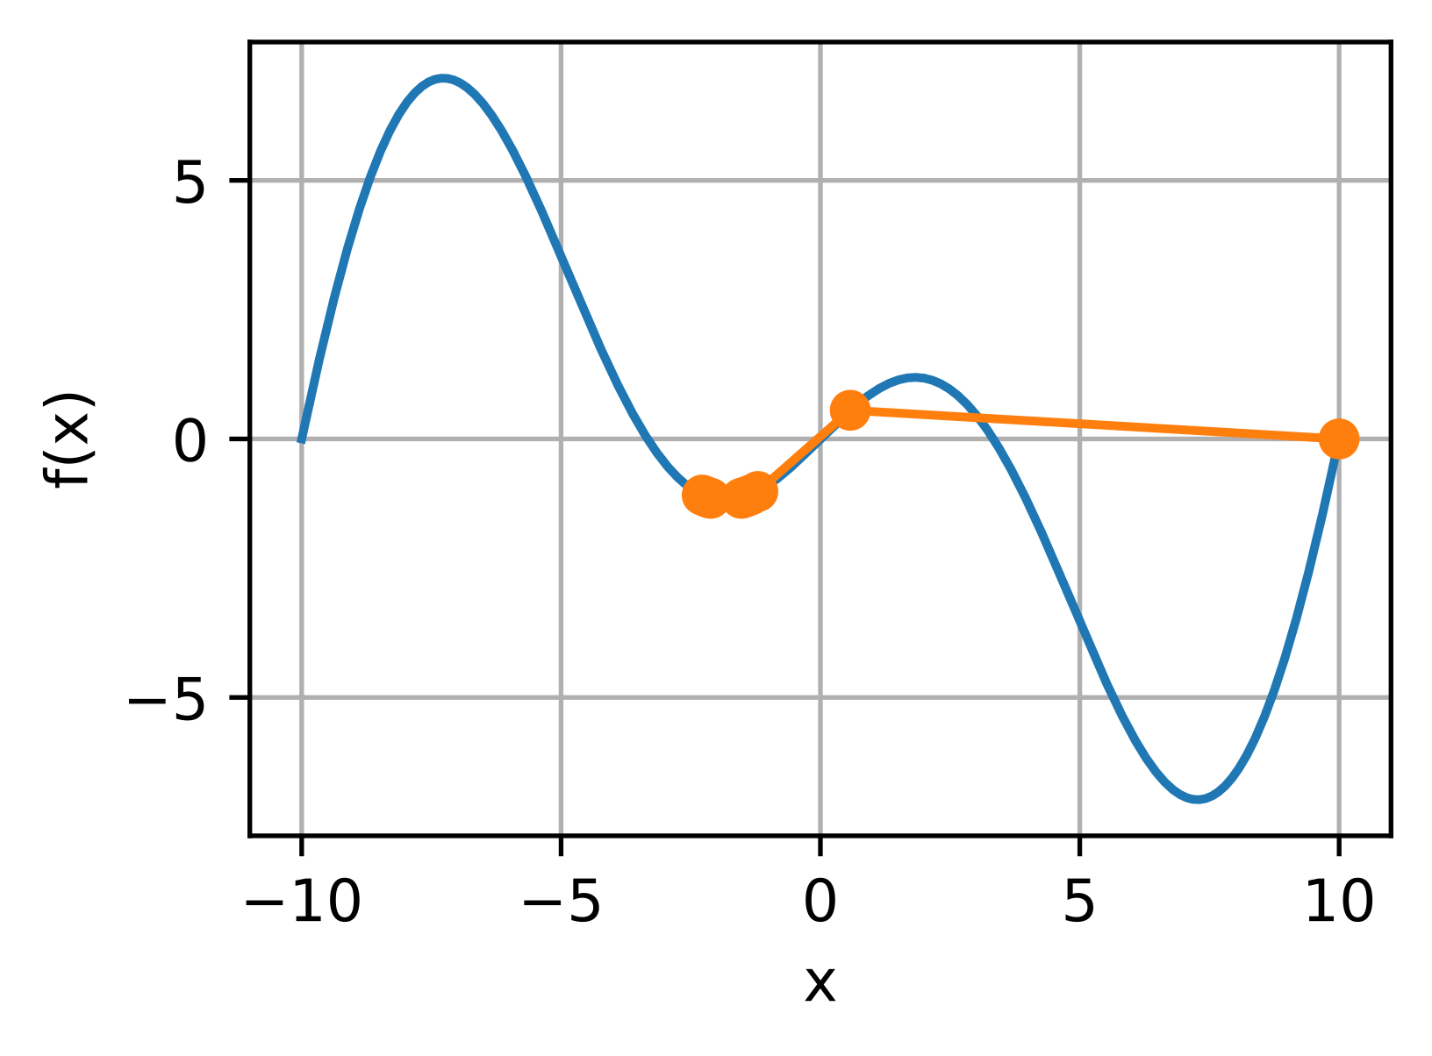
Gradient Descent Method
large
Initial Values
large
Global Minimum

Slide 13
Regression Models

Slide 14
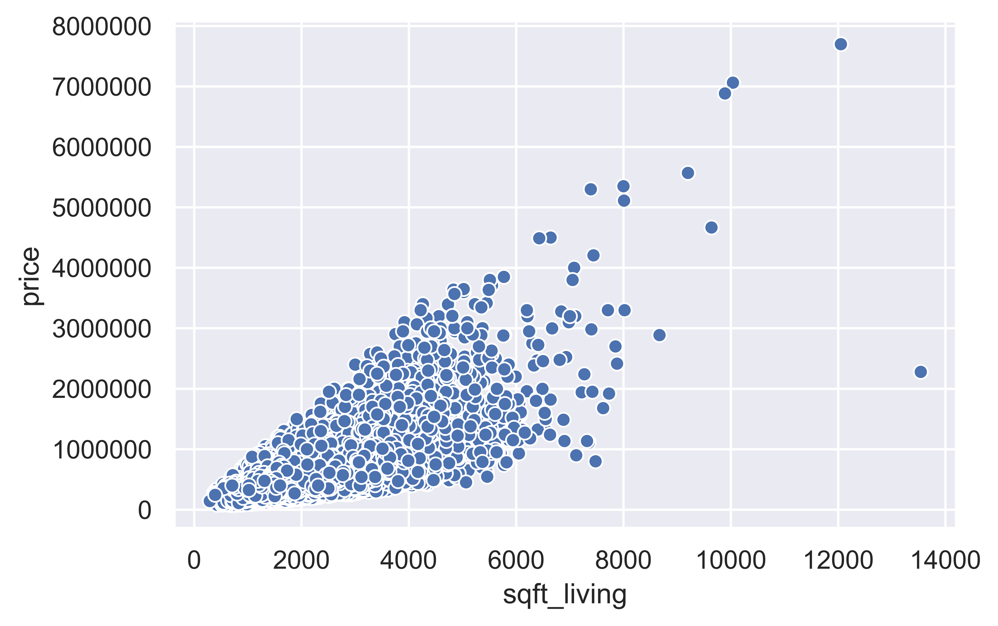
Linear Regression
We use (linear) regression for numerical value prediction.
Example: How does the price of a house (target, outcome , ) change relate to its square footage living (feature, attribute )?
For ,
* Data source: King County, WA Housing Info.

Slide 15
Multiple Linear Regression
Example: How does the price of a house (target, outcome ) change relate to its square footage living (feature ), its number of bedrooms (feature ), its zip code ( ),…? That is, using multiple features…
Using the multiple linear regression equation:
Assuming all other variables stay the same, an increase of by 1 foot square, increases the price by
Assuming all other variables stay the same, an increase of by 1 bedroom, increases the price by , and so on …

Slide 16
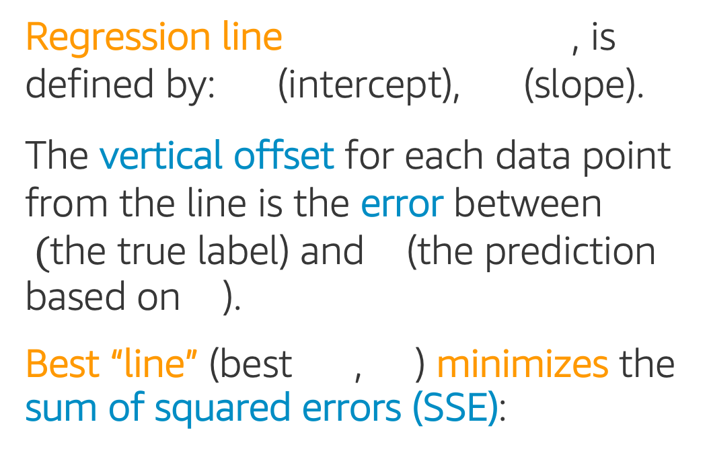
Linear Regression
Regression line , is defined by: (intercept), (slope).
The vertical offset for each data point from the line is the error between $($the true label) and (the prediction based on ).
Best “line” (best , ) minimizes the sum of squared errors (SSE):

Slide 17
Fitting a Model: Gradient Descent
For a Linear Regression model:
with features , and parameters/weights
Minimize the Mean Squared Error cost function:
Iteratively update parameters/weights with Gradient Descent:
,
: index; : number of samples
: output; : model prediction

Slide 18
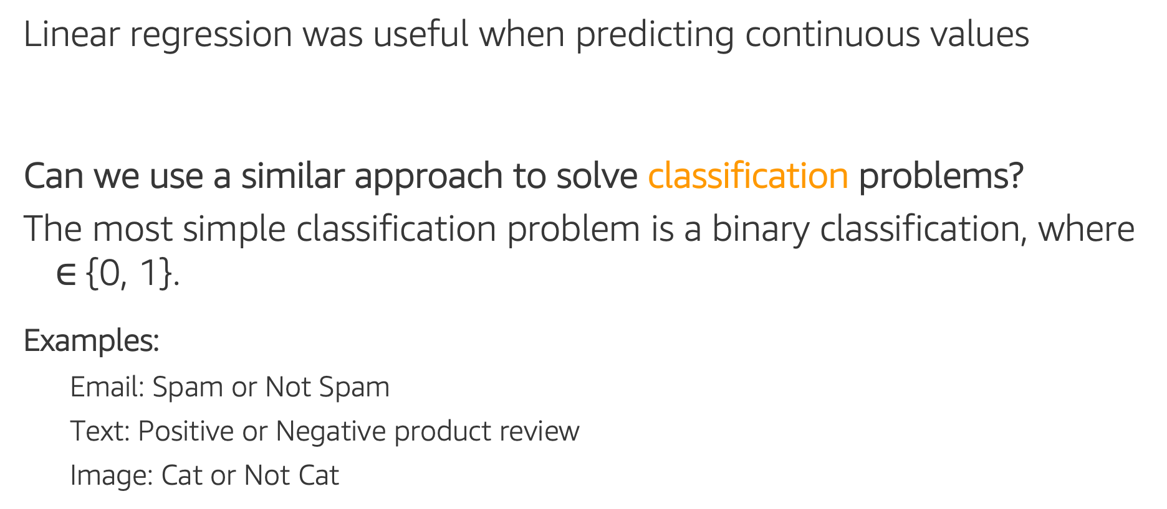
From Regression to Classification
Linear regression was useful when predicting continuous values
Can we use a similar approach to solve classification problems?
The most simple classification problem is a binary classification, where $∈${0, 1}.
Examples:
Email: Spam or Not Spam
Text: Positive or Negative product review
Image: Cat or Not Cat

Slide 19
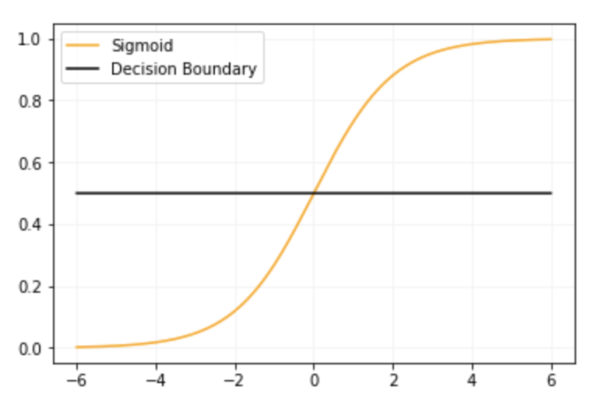
Logistic Regression
Idea: We can apply the Sigmoid function to
Sigmoid (Logistic) function
“squishes” values to the 0 –1 range.
Can define a “Decision boundary” at 0.5
if 0.5, round down (class 0)
if 0.5, round up (class 1)
Our regression equation becomes:

Slide 20
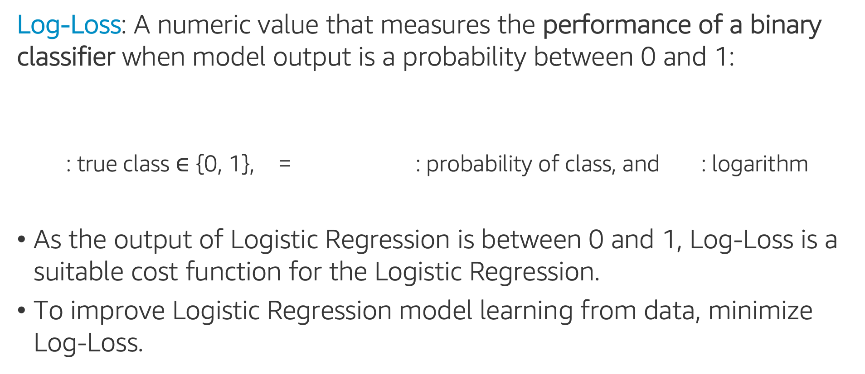
Log-Loss (Binary Cross-Entropy)
Log-Loss: A numeric value that measures the performance of a binary classifier when model output is a probability between 0 and 1:
: true class $∈$ {0, 1}, = : probability of class, and : logarithm
As the output of Logistic Regression is between 0 and 1, Log-Loss is a suitable cost function for the Logistic Regression.
To improve Logistic Regression model learning from data, minimize Log-Loss.

Slide 21
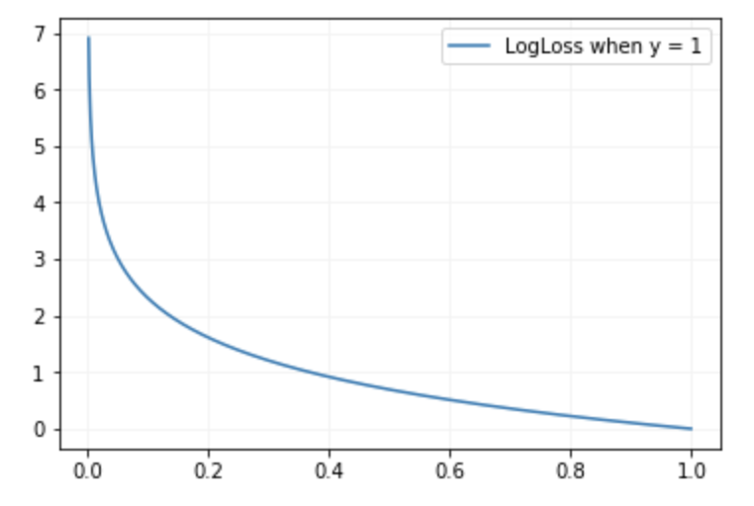
Log-Loss (Binary Cross-Entropy)
Example: Let’s calculate the Log-Loss
for the following scenarios:
: true class = 1, = 0.3
: true class = 1, = 0.8
LogLoss
LogLoss
p=0.3
p=0.8
Better prediction gives smaller Log-Loss
predicted probability
predicted probability

Slide 22
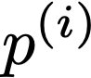
Fitting a Model: Gradient Descent
For a Logistic Regression model:
with features , and parameters/weights
Minimize the LogLoss cost function:
Iteratively update parameters/weights with Gradient Descent:
,
: index; : # samples
: output
: model prediction

Slide 23
Regularization

Slide 24

Regularization
Underfitting: Model too simple, fewer features, smaller weights, weak learning.
Overfitting: Model too complex, too many features, larger weights, weak generalization.
‘Good Fit’ Model: Compromise between fit and complexity (drop features, reduce weights).
Regularization does both: penalizes large weights, sometimes reduced all the way to zero!

Slide 25
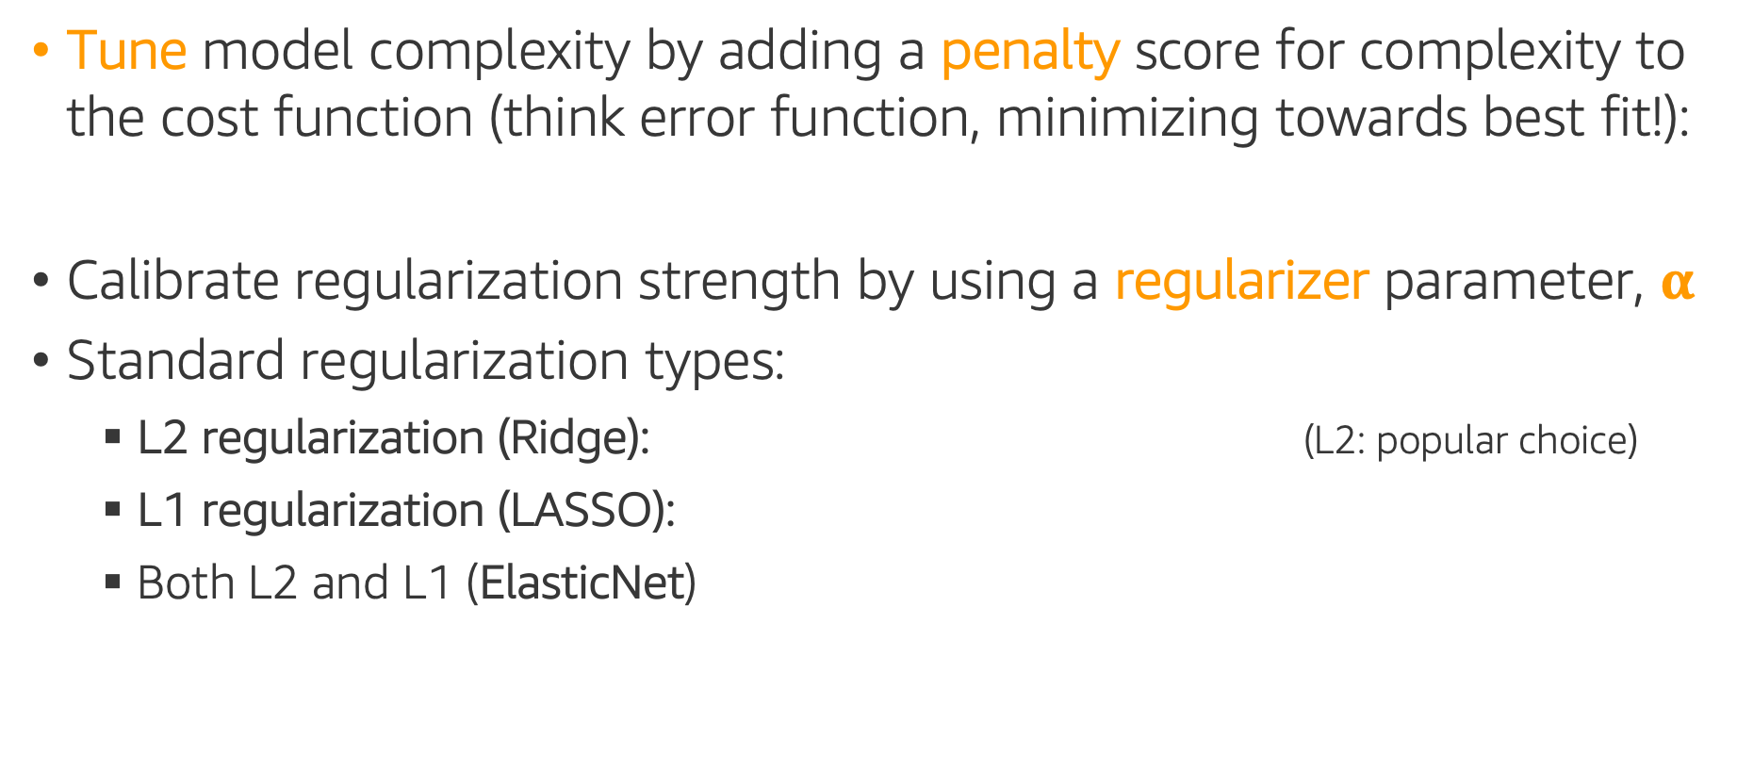
Regularization
Tune model complexity by adding a penalty score for complexity to the cost function (think error function, minimizing towards best fit!):
Calibrate regularization strength by using a regularizer parameter, $α$
Standard regularization types:
L2 regularization (Ridge): (L2: popular choice)
L1 regularization (LASSO):
Both L2 and L1 (ElasticNet)
(L1: useful as feature selection, since most weights shrink to 0 - sparsity)
Note: Important to scale features first!

Slide 26
Regression in sklearn
LinearRegression: sklearn Linear Regression (and regularization)
LinearRegression()
Ridge(alpha=1.0), RidgeCV(alpha=1.0, cv=5)
Lasso(alpha=1.0), LassoCV(alpha=1.0, cv=5)
ElasticNet(alpha=1.0, l1_ratio=0.5), ElasticNetCV(cv=5)
LogisticRegression: sklearn Logistic Regression (and regularization)
LogisticRegression(penalty='l2', C=1.0, l1_ratio=None)
LogisticRegressionCV(penalty='l2', C=1.0, l1_ratio=None, cv=5)

Slide 27
Ensemble Methods: Boosting

Slide 28
Boosting
Boosting method: build multiple weak models sequentially, each subsequent model attempting to boost performance overall, by overcoming/reducing the errors of the previous model.
Data
…
Weak Model
Weak Model
Weak Model
Prediction 1
Prediction 2
Prediction 2
Ensemble Prediction

Slide 29
Boosting
Boosting method: build multiple weak models sequentially, each subsequent model attempting to boost performance overall, by overcoming/reducing the errors of the previous model.
Data
Data
Data
…
Weak Model
Weak Model
Weak Model
Prediction 1
far from target
Prediction 2
far from target
Prediction 3
far from target

Slide 30
Boosting
Boosting method: build multiple weak models sequentially, each subsequent model attempting to boost performance overall, by overcoming/reducing the errors of the previous model.
Data 1
Weak Model 1
Prediction
far from target
large error
Ensemble Prediction

Slide 31
Boosting
Boosting method: build multiple weak models sequentially, each subsequent model attempting to boost performance overall, by overcoming/reducing the errors of the previous model.
Data 1
Weak Model 1
Prediction
far from target
large error
Ensemble Prediction

Slide 32
Boosting
Boosting method: build multiple weak models sequentially, each subsequent model attempting to boost performance overall, by overcoming/reducing the errors of the previous model.
Data 1
Data 2
Weak Model 1
Weak Model 2
Prediction
far from target
large error
Ensemble Prediction

Slide 33
Boosting
Boosting method: build multiple weak models sequentially, each subsequent model attempting to boost performance overall, by overcoming/reducing the errors of the previous model.
Data 1
Data 2
Weak Model 1
Weak Model 2
Prediction
far from target
large error
Prediction
far from target
still large error
Ensemble Prediction

Slide 34
Boosting
Boosting method: build multiple weak models sequentially, each subsequent model attempting to boost performance overall, by overcoming/reducing the errors of the previous model.
Data 1
Data 2
…
Weak Model 1
Weak Model 2
…
Prediction
far from target
large error
Prediction
far from target
still large error
…
Ensemble Prediction
…

Slide 35
Gradient Boosting Machines (GBM)
Gradient Boosting Machines (GBM): Boosting trees
Train a weak model on the given data, and make predictions with it
Iteratively create a new model to learn to overcome prediction errors of the previous model (use previous prediction error as new target)
Features
Features
Features
Features
Target 1
Target 2
Target 3
…
Target N
Target 1- Prediction 1
Target 2- Prediction 2
Target 3- Prediction 3
Tree 1
Tree 2
Tree 3
…
Tree N
Prediction 1
Prediction 2
Prediction 3
…
Prediction N
Prediction 1 + Prediction 2 + Prediction 3 + … + Prediction N

Slide 36
Gradient Boosting in Python
sklearn GBM algorithms:
GradientBoostingClassifier (Regressor)
HistGradientBoostingClassifier (Regressor) – faster, experimental
Additional third-party libraries provide computationally efficient alternate GBM implementations, with better results in practice:
XGBoost (Extreme Gradient Boosting): efficient compute, memory
LightGBM: much faster
CatBoost (Category Gradient Boosting): fast, supports categoricals

Slide 37
Gradient Boosting in sklearn
GradientBoostingClassifier: sklearn’s Gradient Boosting classifier (there is also a Regressor version) -
GradientBoostingClassifier(n_estimators=100, learning_rate = 0.1,
min_samples_split=2, min_samples_leaf=1, max_depth=3)
The full interface is larger.
Notice the mix of boosting-specific and tree-specific parameters.
.fit(), .predict()

Slide 38
Gradient Boosting in sklearn
HistGradientBoostingClassifier: sklearn’s Light GBM classifier (there is also a Regressor version), in experimental stage -
from sklearn.experimental import enable_hist_gradient_boosting
HistGradientBoostingClassifier(max_iter=100, learning_rate = 0.1,
max_leaf_nodes=31, min_samples_leaf=20, max_depth=None)
The full interface is larger.
.fit(), .predict()

Slide 39
Neural Networks

Slide 40
Looking back at Regression Models
Linear Regression*: Given { }, predict :
Output
(sum)
(weights)
Input
* Basically assuming that the output depends only on first order interactions of the inputs

Slide 41
Looking back at Regression Models
Linear Regression*: Given { }, predict :
where is the linear function:
Output
Activation function
(sum)
(weights)
Input
* Linear activation function

Slide 42
Looking back at Regression Models
Logistic Regression*: Given { }, predict , where ::
where is the logistic function:
Output
Activation function
(sum)
(weights)
Input
* Non-linear activation function / binary classifier

Slide 43
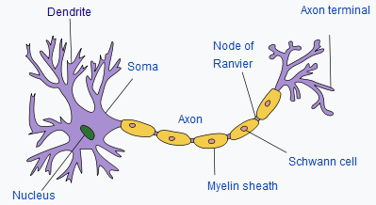
Perceptron (Rosenblatt, 1957)
Perceptron*: Given { }, predict , where :
where is the step function:
Output
Activation function
(sum)
(weights)
Input
* Non-linear activation function / binary classifier

Slide 44
Artificial Neuron
Artificial Neuron*: Given { }, predict :
where is a nonlinear activation function (sigmoid, tanh, ReLU, …)
Output
Activation function
(sum)
(weights)
Input
* Similar to how neurons in the brain function

Slide 45
Artificial Neuron
Output
Artificial Neuron: Captures mostly linear interactions in the data.
Question: Can we use a similar approach to capture non-linear interactions in the data?
Activation function
(sum)
(weights)
Input
Not a very good classifier …

Slide 46
Neural Network/Multilayer Perceptron
Output
Artificial Neuron: Captures mostly linear interactions in the data.
Question: Can we use a similar approach to capture non-linear interactions in the data?
(3 weights)
(6 weights)
Input
Much better!

Slide 47
Neural Network/Multilayer Perceptron
Artificial Neuron: Captures mostly linear interactions in the data
Question: Can we use a similar approach to capture non-linear interactions in the data?
Neural Network/Multilayer Perceptron (MLP): Use more Artificial Neurons, stack in a layer!
Output Layer
(3 weights)
Hidden Layer
(6 weights)
Input Layer

Slide 48
Neural Network/Multilayer Perceptron
A neural network consisting of input, hidden and output layers.
Each layer is connected to the next layer.
An activation function is applied on each hidden layer (and output layer).
More details
Output Layer
(3 weights)
Hidden Layer
(6 weights)
Input Layer

Slide 49
Neural Network/Multilayer Perceptron
A neural network consisting of input, hidden and output layers.
Each layer is connected to the next layer.
An activation function is applied on each hidden layer (and output layer).
More details
Output Layer
(5 weights)
Hidden Layer
(12 weights)
Input Layer

Slide 50
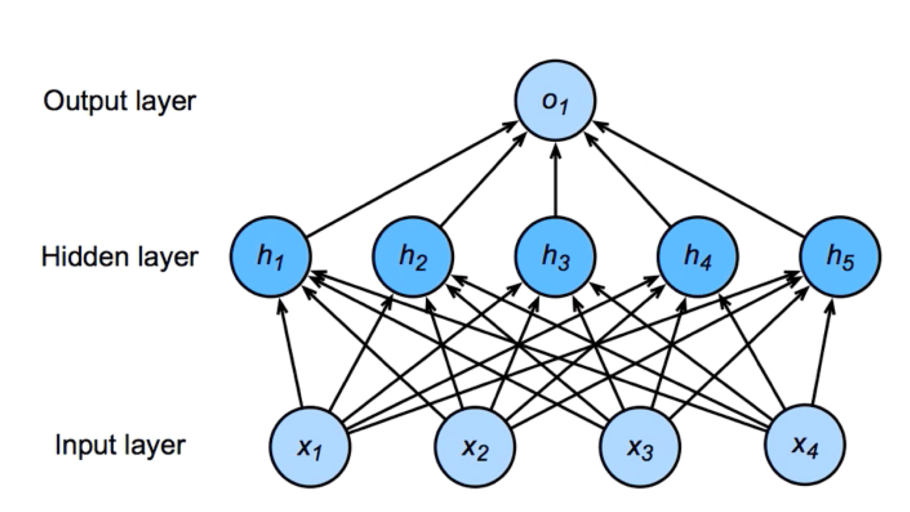
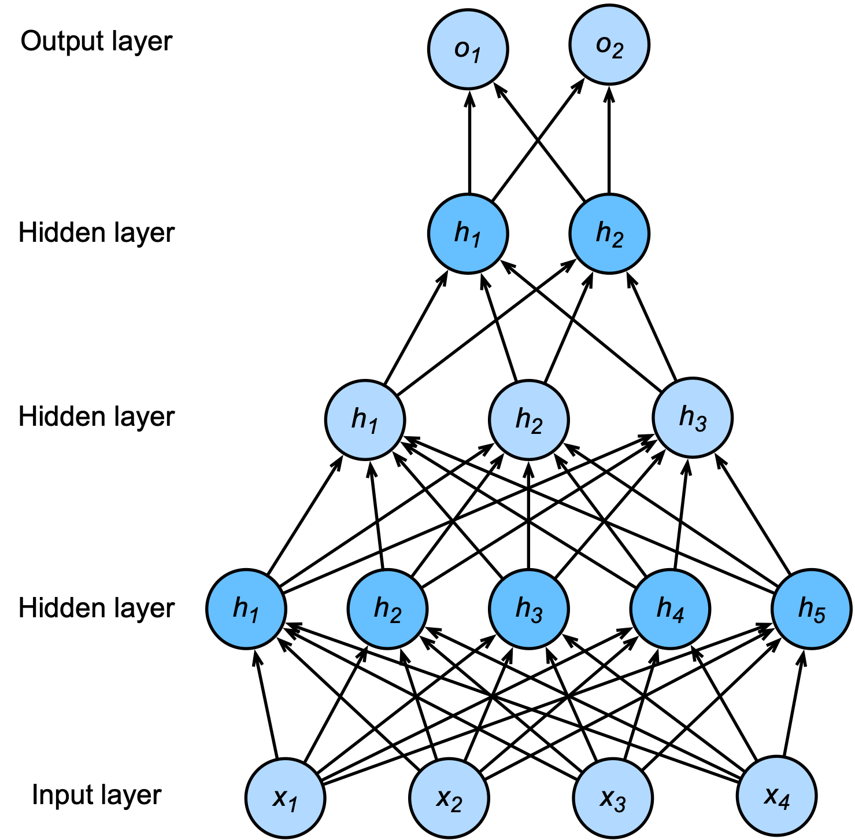
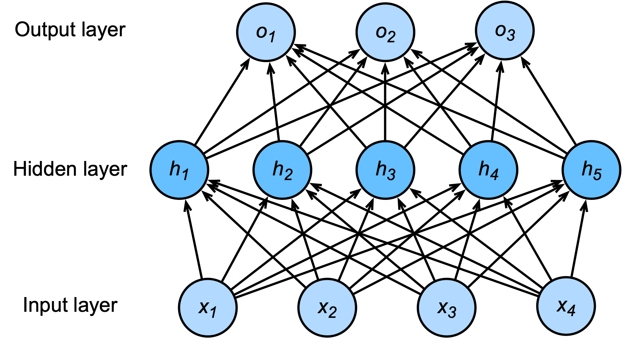
Neural Networks
MultiLayer Network: Two layers (one hidden layer, output layer), with five hidden neurons in the hidden layer, and one output neuron.
MultiLayer Network: Two layers (one hidden layer, output layer), with five hidden neurons in the hidden layer, and three output neurons.
MultiLayer Network: Four layers (three hidden layer, output layer), with five-three-two hidden neurons in the hidden layers, and two output neurons.
More details

Slide 51
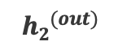
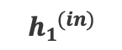
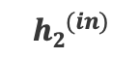
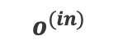
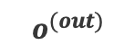
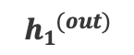
Build and Train a Neural Network
We build a neural network for a binary classification task, with:
(no bias, for simplicity)
2 inputs: = 0.5 and = 0.1
1 hidden layer with 2 neurons
1 output neuron in the output layer
$$o^{(out)}$$
Output Layer
$$o^{(in)}$$
$${h1}^{(out)}$$
$${h2}^{(out)}$$
Hidden Layer
$${h1}^{(in)}$$
$${h2}^{(in)}$$
Input Layer

Slide 52
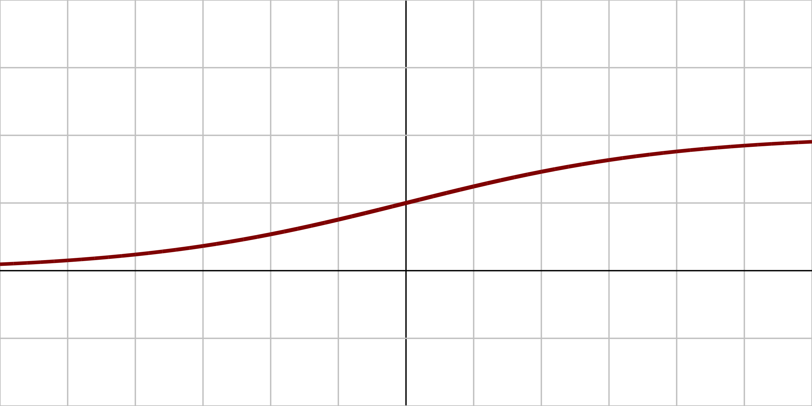
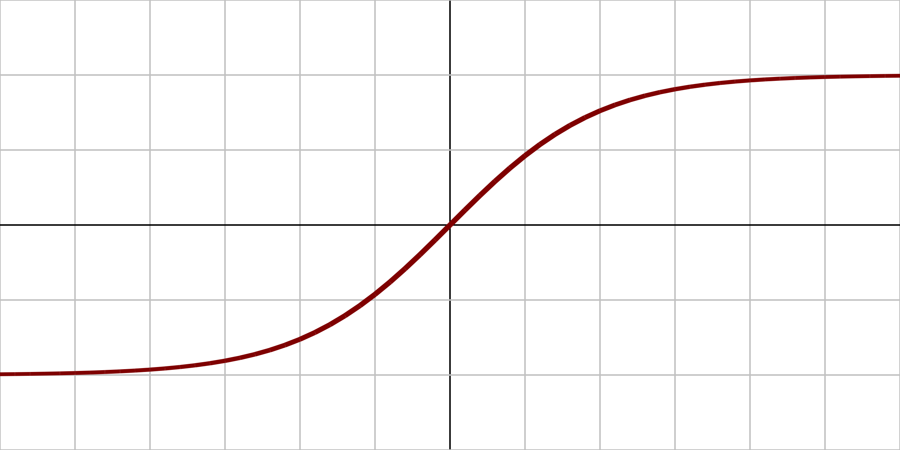
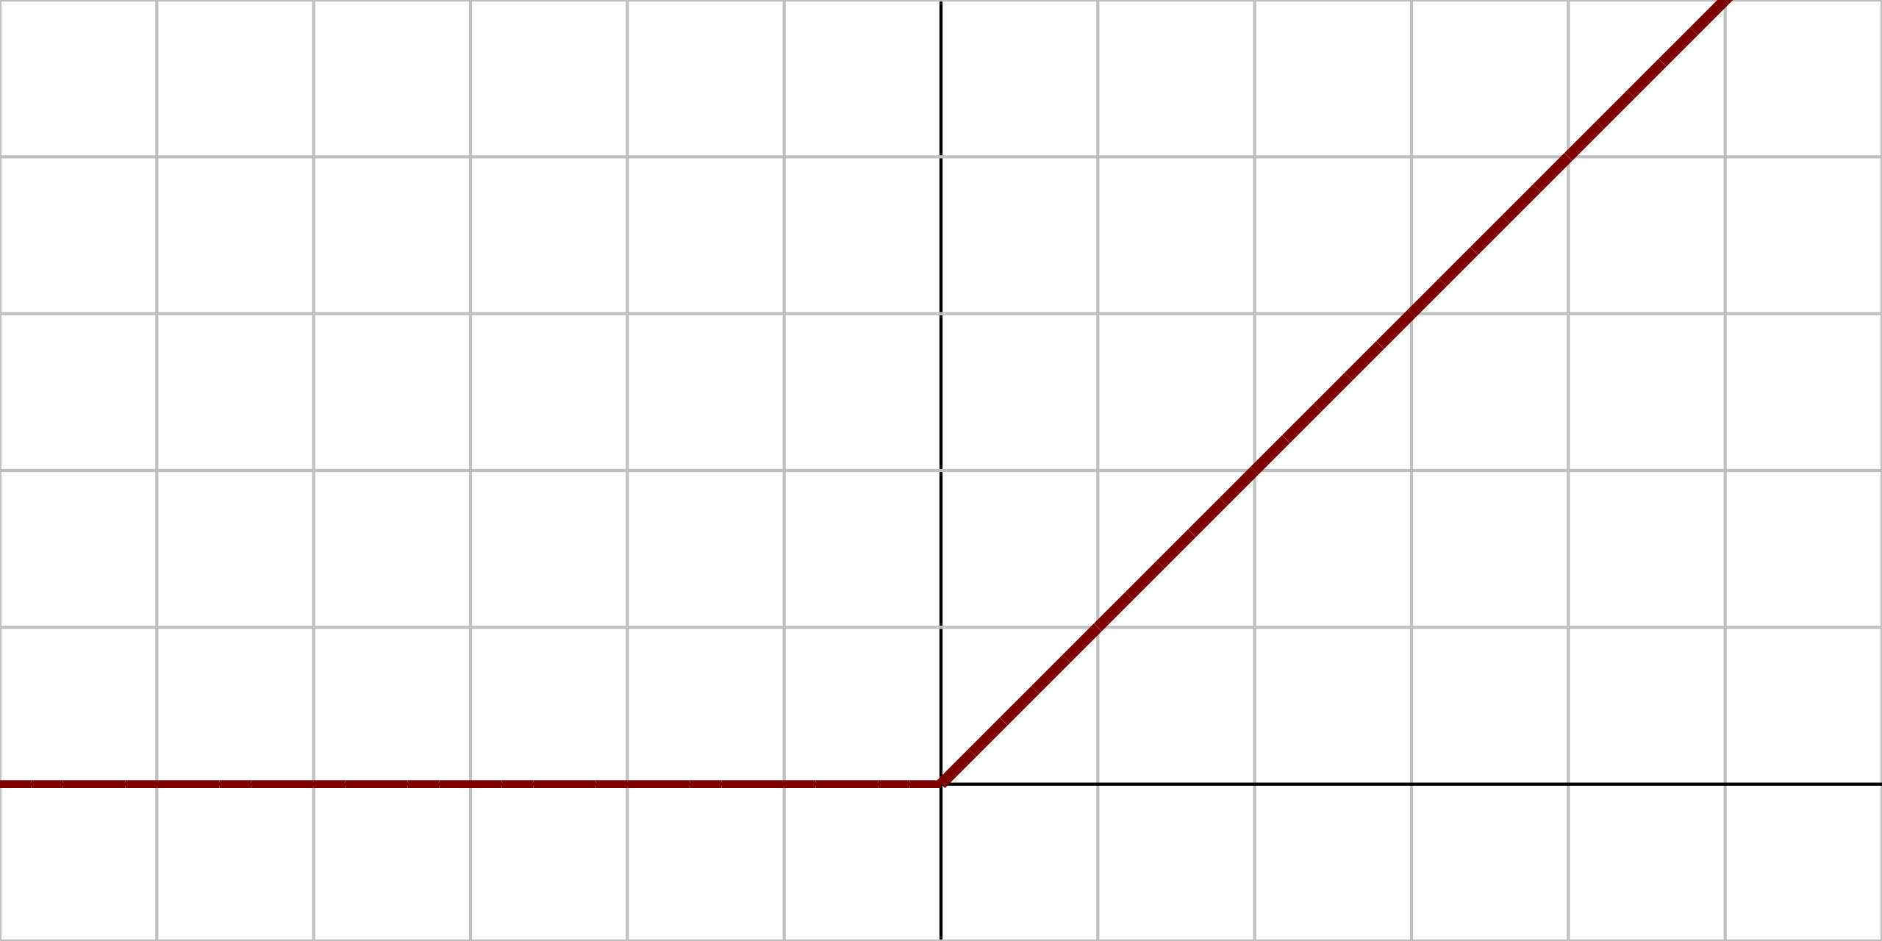
Activation Functions
“How to get from linear weighted sum input to non-linear output?”
Derivatives of these functions are also important (gradient descent).
Name | Plot | Function | Description
Logistic (sigmoid) |  |  | The most common activation function. Squashes input to (0,1).
Hyperbolic tangent (tanh) |  |  | Squashes input to (-1, 1).
Rectified Linear Unit (ReLU) |  |  | Popular activation function. Anything less than 0, results in zero activation.
1
0
x
1
0
x
-1
0
x

Slide 53
Output Activations/Functions
“How to output/predict a result”
Problem | Description | Name | Function
Binary classification | Output probability for each class, in (0,1) Logistic regression of output of last layer | Sigmoid
Multi-class classification | Output probability for each class, in (0,1) Sum of outputs to be 1 (probability distribution) Training drives target class values up, others down | Softmax
Regression |  | Linear/ ReLU

Slide 54
Build and Train a Neural Network
We build a neural network for a binary classification task, with:
(no bias, for simplicity)
2 inputs: = 0.5 and = 0.1
1 hidden layer with 2 neurons
1 output neuron in the output layer
All neurons have sigmoid activation function:
$$o^{(out)}$$
Output Layer
$$o^{(in)}$$
$${h1}^{(out)}$$
$${h2}^{(out)}$$
Hidden Layer
$${h1}^{(in)}$$
$${h2}^{(in)}$$
Input Layer

Slide 55
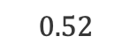
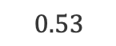

Forward Pass
$$o^{(out)}$$
Output Layer
$$o^{(in)}$$
0.4
0.45
$$0.52$$
$$0.53$$
Hidden Layer
$$0.1$$
0.13
0.25
0.2
0.15
0.4
Similarly,
0.5
0.1
Input Layer

Slide 56
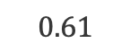
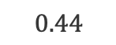
Forward Pass
$$0.61$$
Output Layer
$$0.44$$
0.4
0.45
$$0.52$$
$$0.53$$
Hidden Layer
$$0.1$$
0.13
0.25
0.2
For binary classification, we would classify this (0.5, 0.1) input data point, as class 1 (as 0.61 > 0.5).
0.15
0.4
0.5
0.1
Input Layer

Slide 57
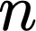

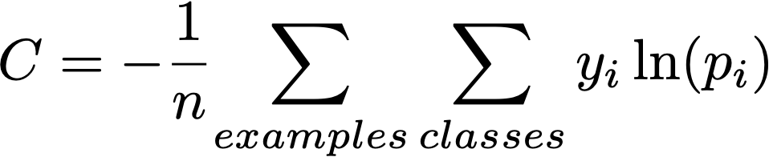
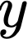
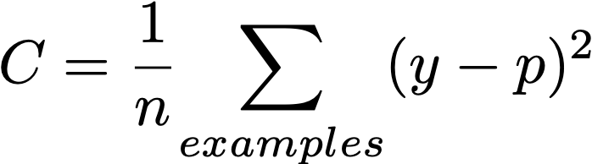
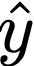
Cost Functions
“How to compare the outputs with the truth?”
Problem | Name | Function | Notes
Binary classification | Cross entropy for logistic |  | Notations for Classification = training examples = classes = prediction (probability) = true class (1/yes, 0/no)
Multi-class classification | Cross entropy for Softmax
Regression | Mean Squared Error |  | Notations for Regression = training examples = prediction (numeric, ) = true value

Slide 58
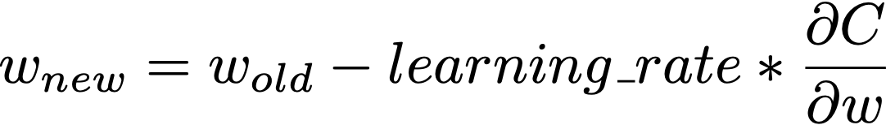

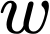
Training Neural Networks
Cost function is selected according to problem: Binary, Multi-class Classification or Regression.
Update network weights by applying the gradient descent method and backpropagation. More details
Weight update formula:
: Cost
Gradient with respect to

Slide 59
Dropout
Regularization technique to prevent overfitting.
Randomly removes some nodes with a fixed probability during the training.
More details

Slide 60
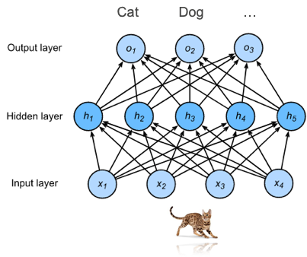
Why Neural Networks?
Automatically extract useful features from input data.
In recent years, deep learning has achieved state-of-the art results in many machine learning areas.
Three pillars of deep learning:
Data
Compute
Algorithms

Slide 61
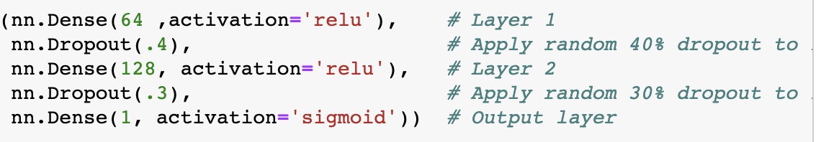

Build and Train Neural Networks
How to build and use these ML models?
Can it be this simple?

Slide 62

Dive into Deep Learning
E-book on Deep Learning by Amazon Scientists, available here: https://d2l.ai
Related chapters:
Chapters 3: Linear Neural Networks: https://d2l.ai/chapter_linear-networks/index.html
Chapters 4: Multilayer Perceptrons: https://d2l.ai/chapter_multilayer-perceptrons/index.html

Slide 63

MXNet Hands-on
Open source Deep Learning Library to train and deploy neural networks.
With the Gluon interface, we can define and train neural networks easily.
MLA-TAB-Lecture3-MXNet.ipynb

Slide 64
Putting it all together: Lecture 3
In this notebook, we continue to work with our review dataset to predict the target field
The notebook covers the following tasks:
Exploratory Data Analysis
Splitting dataset into training and test sets
Data Balancing, categoricals encoding, text vectorization
Train a Neural Network
Check the performance metrics on test set
MLA-TAB-Lecture3-Neural-Networks.ipynb

Slide 65
AutoML

Slide 66
AutoML
AutoML helps automating some of the tasks related to ML model development and training such as:
Preprocessing and cleaning data
Feature selection
ML model selection
Hyper-parameter optimization

Slide 67

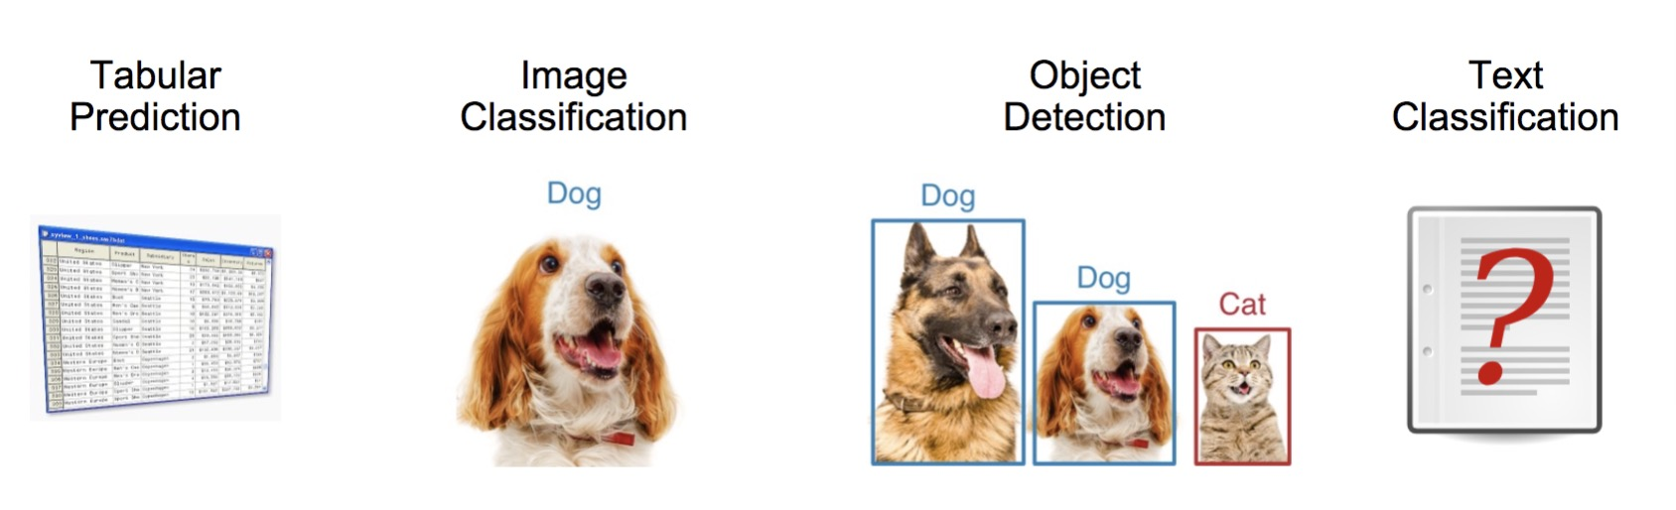
Auto AutoML
Open source AutoML Toolkit (AMLT) created by Amazon AI.
Easy to Use – Built-in Application

Slide 68
Auto AutoML
AutoGluon is able to produce top solutions to many real-world business problems. AutoGluon was utilized to create:
The first place solution to the MLA NLP I Hazmat Challenge
First place against over 1,000 competitors and 10,000 manual submissions over the course of 12 months.
The first place solution to the MLE Ops Tech IT Challenge
The first place solution to the SCOT Grand Challenge 2018
Solution was able to determine if two products are identical better than a human evaluator.
Used as the production solution to the product matching problem within Amazon.
The first place solution to the SCOT Grand Challenge 2019
Solution approximately halved the predictive error of Amazon.com shipment costs worldwide.
The existing production solution to Amazon Grocery (F3) sales forecasting
pip install to get started: https://github.com/awslabs/autogluon

Slide 69
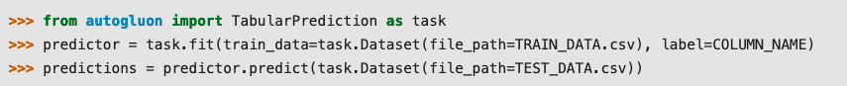
Auto AutoML
With AutoGluon, state-of-the-art ML results can be achieved in a few lines of Python code.

Slide 70
Auto AutoML
With AutoGluon, state-of-the-art ML results can be achieved in a few lines of Python code.
MLA-TAB-Lecture3-AutoGluon.ipynb

Slide 71
THANK YOU

